Slide 1
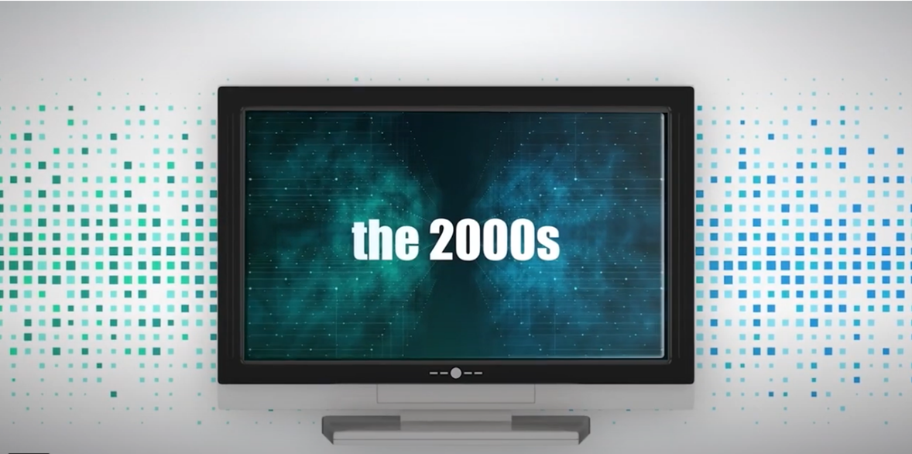

Fidelity Life in the 2000’s.
This year Fidelity Life is celebrating 50 years as a successful homegrown business. To mark the milestone, they’re taking a walk down memory lane decade by decade.
We’re up to the 2000’s and what a big decade it was for Fidelity Life.
Fear of the Y2K bug, a flurry of activity with a new logo introduced, founder Gordon Watson retired and a brand-new partnership with FMG established.
Watch the video.

