Slide 1
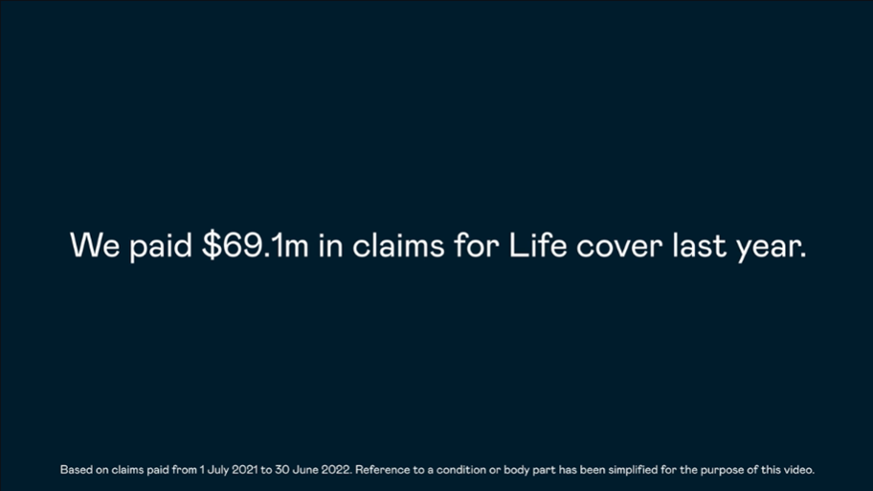

Fidelity Life’s 3rd claims video – Life cover.
What were the top Life cover conditions claimed for last year that resulted in $69.1m paid out. Find out in this video.
Watch the video.

