Slide 1
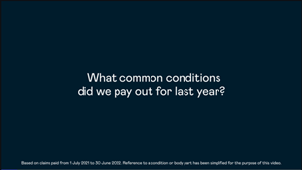

What were the most common claims that Fidelity Life paid out for last year?
This is the second in Fidelity Life’s claims highlights video series.
For more detail on claims contact your Business manager or Strategic alliance manager.
Watch the video.

